Slide 1







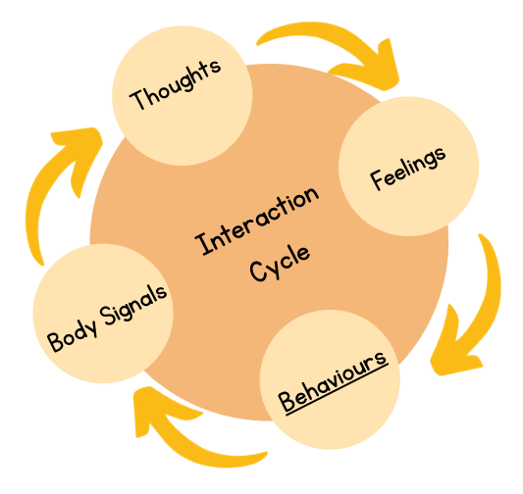



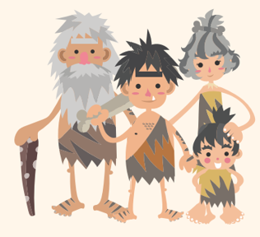



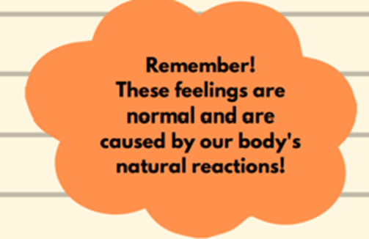


Psychoeducation for anxiety
delivered by the Mental Health Support Team
why do we worry?
what is anxiety
why me?
90 minute workshop which looks at anxiety and worry and provides useful strategies to help

