Slide 1
In Wigan, we believe all children should feel happy, cared for, safe and ready
to learn.
Here’s how…
Visit your local Start Well Family Centre to find out what’s going on near you

Slide 2
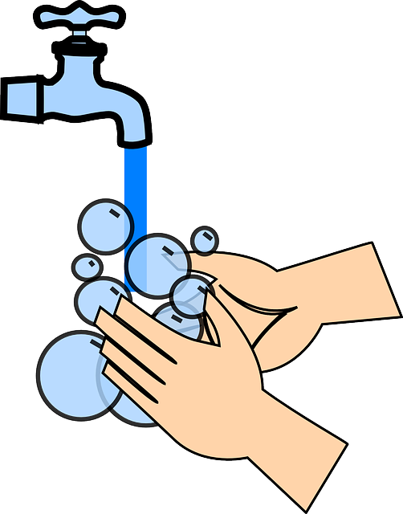
Children are individuals, and all develop at their own pace,
but as a Parent or Carer you are their greatest teacher and role model.
To prepare them for school:
Teach & help them with their toilet training,
and to wash their hands afterwards
  Reduce Dummy time to bed time only
  Teach them to dress themselves;
    Put on their own coat
    Fasten zips & buttons
    Use a knife & fork
    Open packets and peel fruit
Visit your local Start Well Family Centre to find out what’s going on near you

Slide 3


Children under 5 should be active for at least 3 hours a day. This includes:
  Spinning around,
  Going on swings,
  Crawling like a bear,
  Slithering like a snake,
  Rolling down hills,
Play can be indoors or out – simply walking to the shops counts too.
Did you know, climbing frames help develop the right muscles for writing?
Visit your local Start Well Family Centre to find out what’s going on near you

Slide 4
How do I help my child build healthy relationships?
Have a regular routine to let your child know what happens next; think bath time & stories to help your child unwind for bed
Help them recognise it’s ok to not be happy all the time, talk about being happy, sad or tired and how that feels for them
Socialise at groups and with family and friends
‘Together time’ is crucial
Show them how to share & take turns with others
Looking for Childcare Near You?
For more information including information about 2 and 3 year old funded childcare, visit www.wigan.gov.uk/familydirectory

Slide 5


Platt Bridge Start Well Family Centre
Rivington Ave, Platt Bridge,
Wigan. WN2 5NG
01942 487999
Supporting the communities of Hindley and Hindley Green; Abram and Platt Bridge; Ashton and Bryn.

Slide 6
Atherton Start Well Family Centre,
Formby Ave, Atherton. M46 0HX
01942 486366 (Option 2) or text 07825 832685
Supporting the communities of Atherton, Tyldesley,
Astley and Mosley Common
For regular updates, please visit our Facebook page www.facebook.com/athertonstartwellfamilycentre

Slide 7
Westfield Start Well Family Centre,
Montrose Ave, Wigan, WN5 9XN
01942 776007 (Option 2) email: westfield_cc@wigan.gov.uk
Supporting the communities of Pemberton; Winstanley and Highfield; Orrell and Billinge; Worsley Menses,
Hawkley Hall and Goose Green
For regular updates, please visit our Facebook page www.facebook.com/westfieldstartwellfamilycentre

Slide 8
Westleigh Start Well Family Centre,
Westleigh Lane, Leigh, WN7 5NJ
01942 777705
Supporting the communities of Leigh, Golborne and Lowton
For regular updates, please visit our Facebook page www.facebook.com/LLGSSCC

Slide 9
Ince Start Well Centre, Charles Street,
Ince, WN2 2AL
01942 767503
Supporting the communities of Wigan Town Centre;
Standish; Shevington; Ince and Scholes; Aspull,
New Springs and Whelley.
For regular updates, please visit our Facebook page www.facebook.com/incestartwellfamilycentre

